Slide 1
UMKC Hackathon
SENTIMENT ENGINE
Tech Crusaders
Sri Praneeth Iyyapu
Naresh Goud Pogakula
Vihari Gorripati
MounikaYalamanchili

Slide 2
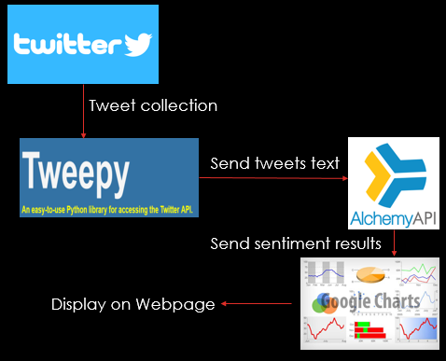
Architecture
Collected Tweets related to trending hashtags on Election Day using Tweepy and Twitter REST api
Hosted these tweets in public url and sent these tweets to Alchemy Api
Got the sentimental analysis results from the Alchemy API and done visualisations using google charts

Slide 3
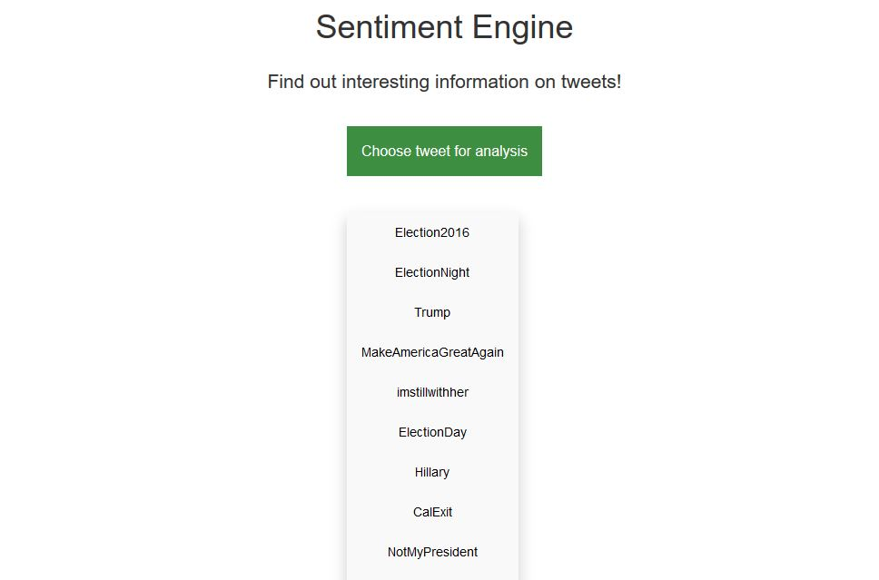
Implementation
Created a Web application by which user can see visualisations(sentimental analysis results) particular to the hashtag.
For each Hash tag, we have displayed 3 charts:
Emotion analysis
Sentiment analysis
Top Keywords and Relevance

Slide 4
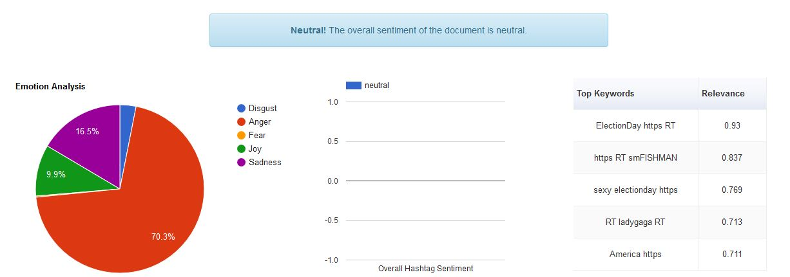
Visualisation on #ElectionDay

Slide 5
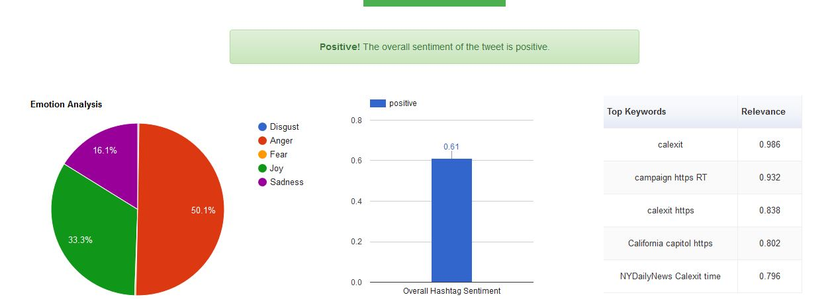
Visualisation on #CalExit

